Slide 1


AAC and Mobile Computing:
Apps for Communication
Krista Mullen, CCC-SLP
Ben Satterfield, Ed.D.

Slide 2
Agenda
Overview of Georgia Tools for Life
Understanding the Difference between Android & Apple & Surface as platforms
What is AAC?
How is communication in 21st Century changing?
Tools: for finding, exploring apps
Exploring a Few of Tools for Life Favorite Apps for AAC
BONUS: Evaluating & Choosing Appropriate Apps

Slide 3
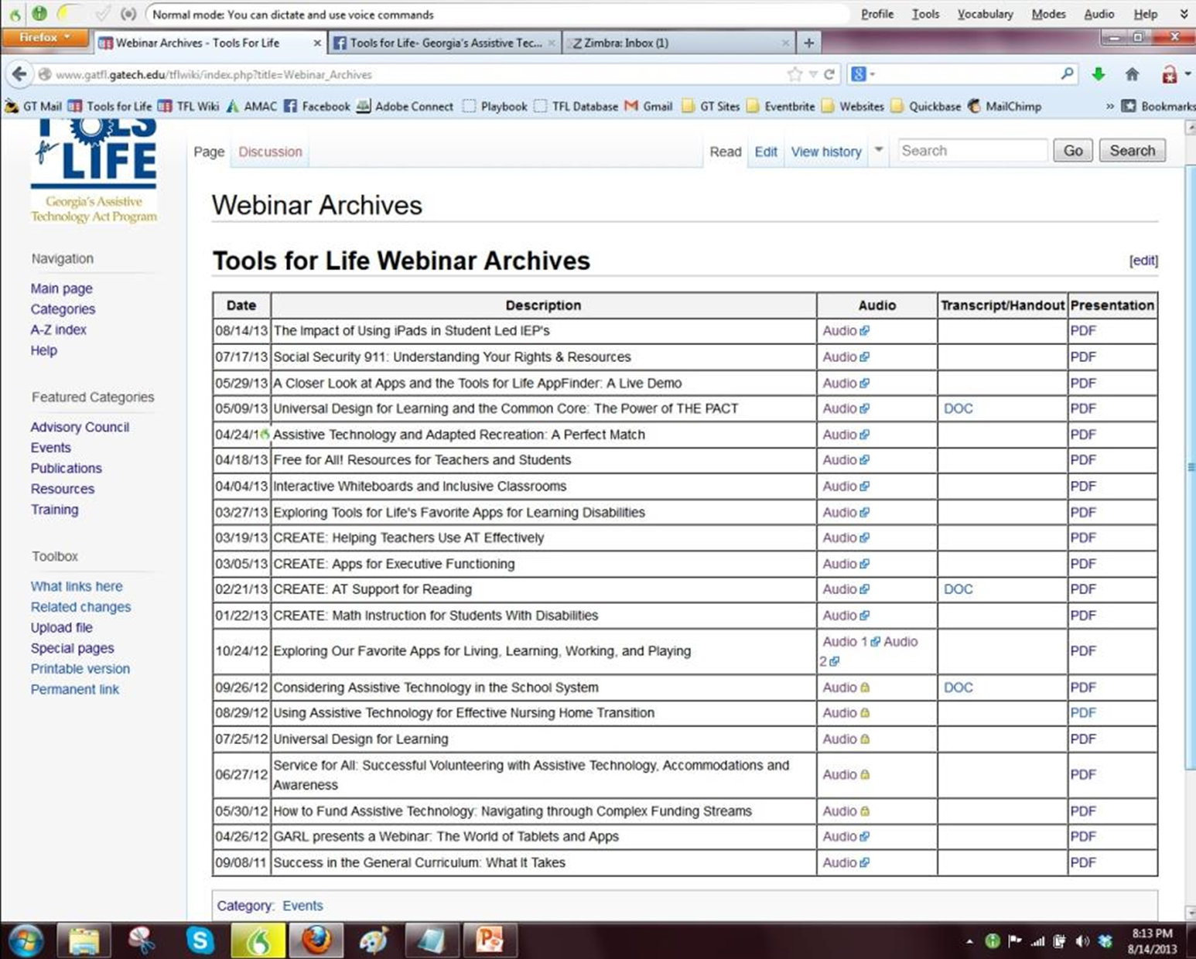
This Session is being Recorded

Slide 4
CEUs and CRCs are Available
CEUs are approved for .10 clock hours and are administered through Georgia Tech Professional Education
CRCs are approved for 1.0 clock hours and are administered through the Commission on Rehabilitation Counselor Certification
  To receive your verification form, send an e-mail with the webinar title and date, your full name, organization, city, state, e-mail address and date of birth to Liz.Persaud@gatfl.gatech.edu

Slide 5
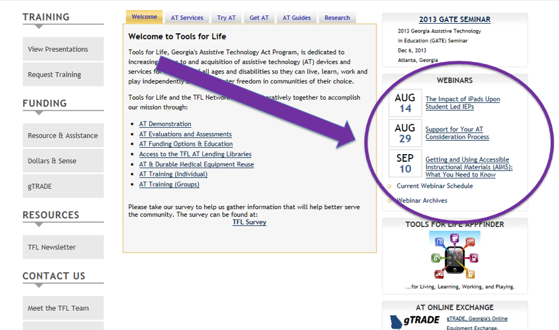
Join us for Upcoming Events!
November 10, 2016 Making Paper-based Classroom Activities Accessible with Joyce Pufnock, Cherokee County Schools
December 9, 2016 GATE Conference (8am-4pm) at the GA Tech Student Center

Slide 6
Webinar Evaluation
At the end of today’s webinar, we ask that you please take a moment to complete our survey:
https://www.research.net/s/TFLwebinar

Slide 7
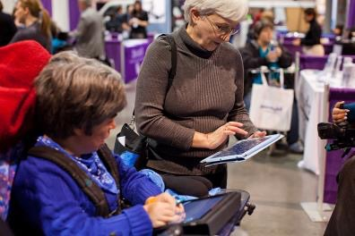
Tools for Life Mission
We’re here to help Georgians with disabilities gain access to and the acquisition of assistive technology devices and assistive technology services so they can live, learn, work, and play independently in the communities of their choice.

Slide 8
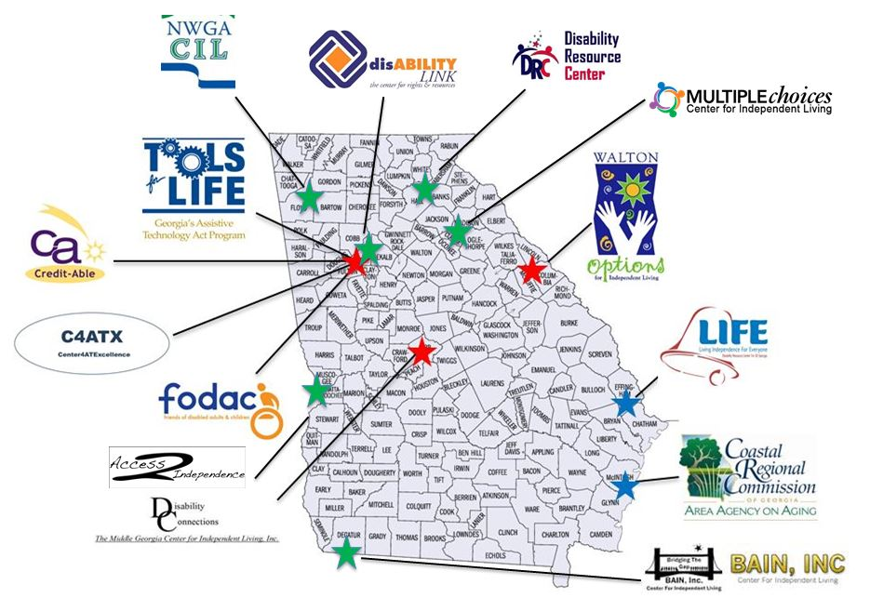
The TFL Network

Slide 9
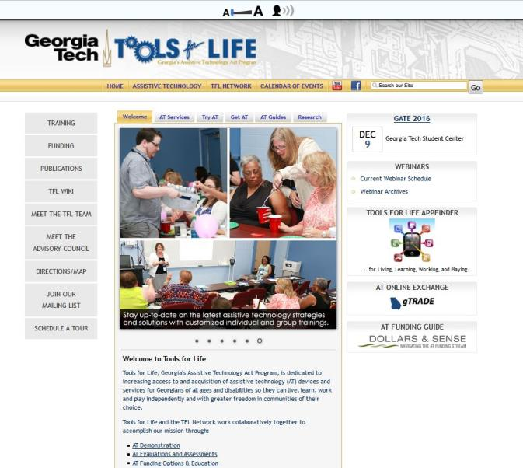
Visit us online!

Slide 10
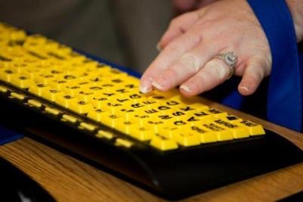
What is Assistive Technology?
Assistive Technology (AT) is any item or piece of equipment that is used to increase, maintain or improve the functional capabilities of individuals with disabilities in all aspects of life, including at school, at work, at home and in the community.
Assistive Technology ranges from no/low/light tech to high tech devices or equipment.

Slide 11
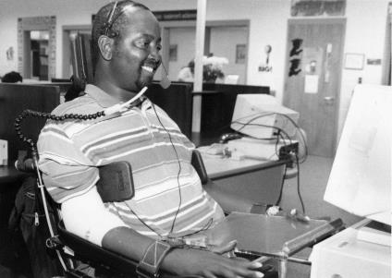
Why Assistive Technology?
For a person without a disability, technology makes life easier.
For a person with a disability, technology makes life possible.
TIP: USE AT! We have yet to meet a successful individual who does not use any AT.

Slide 12
Impact of Apps & Tablets
With the introduction of Apps, we are experiencing a drastic technology evolution that is revolutionizing the field of Assistive Technology and producing positive life changing results for individuals with disabilities.
Apps are assisting students by promoting more independence, increasing opportunities for inclusion, promoting depth of learning, providing equal access in educational settings and supporting smoother transitions.
This session will provide participants with opportunities to explore tablets and their accessibility features as well as learn about some apps that can assist students at school.

Slide 13
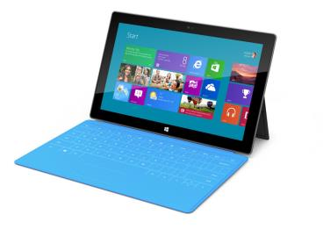
MicroSoft Surface
Windows 10
Slim and has a USB port
Moveable Tiles
Built-in Accessibility
  Speech-to-text
  Narrator
Attachable keyboard/cover available
Surface pen available for writing
Able to use in regular Windows mode or tablet mode

Slide 14
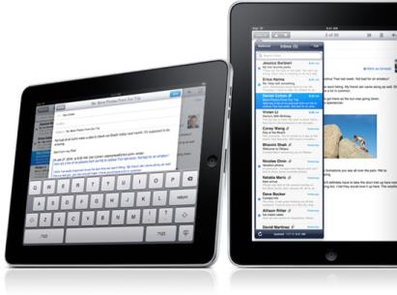
Apple iPad
Multi- touch screen
iOS operating system
Millions of apps
Internet Access
iTunes and App Stores
Videos, Books, Music, Photos
Accessibility options; switch access, text to speech, speech to text, high contrast, etc.
Front and rear facing camera
Available in 4 sizes: 9.7 inch iPad Air 2, 7 inch iPad mini, 12.9 inch iPad Pro, and 9.7 inch iPad Pro

Slide 15
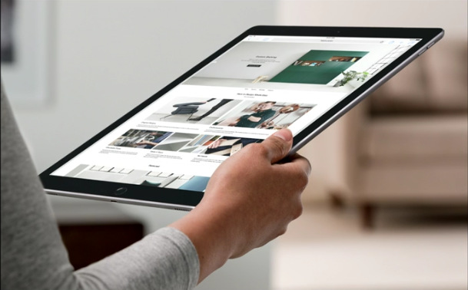
iPad Pro – Additional Features
4 speakers vs. 2 speakers on other models
Smart Connector: transfer data and power between iPad and keypad with no batteries or charging required
Apple SIM available on Wi-Fi + Cellular option – embedded sim card allows purchase of data plan from carrier partner
Available Apple Pencil

Slide 16
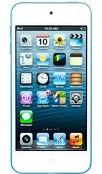
Apple iPod Touch
iOS operating system
Millions of apps
Videos, Music, Books
Internet Access
4” display
Front and rear facing camera
Bluetooth
Available in 16 GB, 32 GB, 64 GB and 128 GB

Slide 17
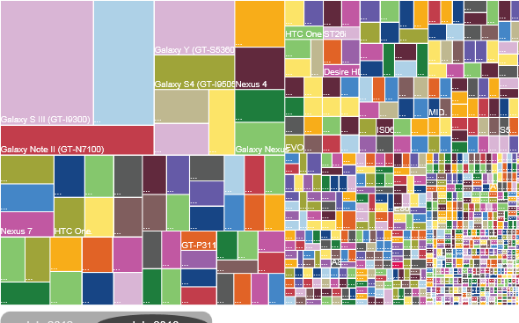
Android Tablets: Fragmentation
July 2012: 3,997
Different Android Devices
July 2013: 11,868
Different Android Devices
July 30, 2013 http://www.ign.com/articles/2013/07/30/heres-what-android-fragmentation-looks-like

Slide 18
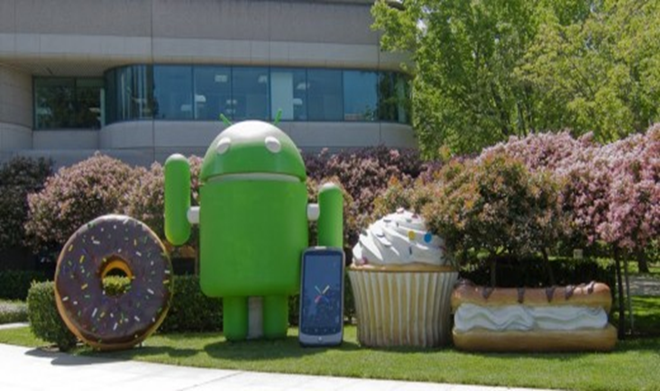
Android OS Version History
Android 1.5 Cupcake
Android 2.3 Gingerbread
Android 4.0 Ice Cream Sandwich
Android 4.1 Jelly Bean
Android 4.4 Kit Kat
Android 5.0 Lollipop
Android 6.0 Marshmallow
Android 7.0 Nougat

Slide 19
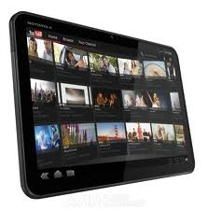
Motorola XOOM
Android System
Must download accessibility features
Compatible with Flash
Camera
Wi-Fi
Uses micro SIM card for external storage

Slide 20
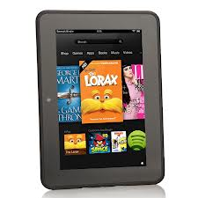
Kindle Fire
Kindle fire 7 (3rd Gen.)
Proprietary version of Android
Amazon Kindle store for apps
7 in (1024 X 600)
Hi-Res display
Dual speakers w/ Dolby Digital Plus
Up to 8 hrs. battery life
Starts at $50
Notes:
Proprietary version of Android
Amazon Kindle store for apps

Slide 21
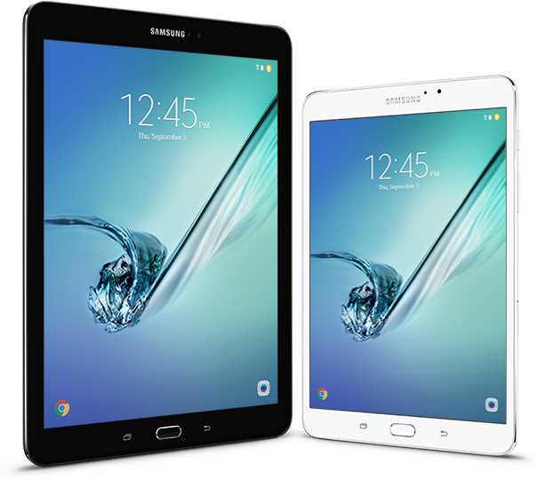
Galaxy Tab A
Screen size: 10.1" x 6.11”
Marshmallow 6.0 OS
Up to 13 hours /chg.
Octa-Core Processor.
32GB† plus up to 200GB
  with microSD™ card.
Quick Connect & SideSync
0.32" Thin;
weighs 1.16lbs
Starts at $299
Notes:
Key Specs
Crystal clear detail. Super AMOLED display.
The power to do it all. Octa-Core Processor.
So much storage. 32GB† plus an additional 128GB with the microSD™ card.**
Connect between devices. Quick Connect*** and SideSync.††
Thin and lightweight. 0.22" Thin; 9.7" weighs .86lbs; 8.0" weighs .58 lbs

Slide 22

Refurbished Tablets
If you do not need the latest and greatest consider an older models for a discount
Want to make sure that refurbish tablets have been certified
Look for at least 1 year warranty
Many places now sell
  Apple
  BestBuy
  Amazon

Slide 23
What Is AAC?
Augmentative & Alternative Communication (AAC)
  ASHA describes AAC as an area of clinical practice that attempts to compensate (either temporarily or permanently) for the impairment and disability patterns of individuals with severe expressive communication disorders including speech-language and writing.
  Should include individual’s full communication abilities: existing speech & vocalizations, gestures, manual signs, communication boards, and speech output devices, etc…
        Sevcik & Romski (2010)

Slide 24
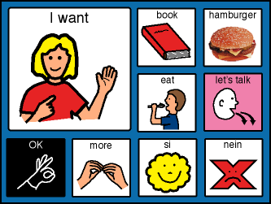

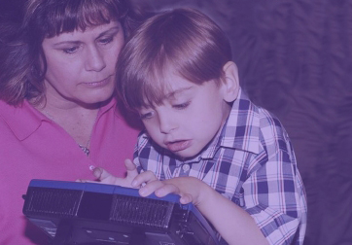
What is AAC?
Symbols
Aids
Techniques
Strategies
        ASHA, (1991)
Notes:
Symbols - methods used for visual, auditory and or tactile representations of conventional concepts
Aids are devices/ physical objects used to transmit or receive messages
Comm bk/ comm bd./ chart, device, computer
Technique – methods by which individual transmits messages
Direct selection
Scanning
Strategies – ways in which AAC aids are used to develop/ enhance an individual’s performance

Slide 25

What Is AAC?
Historically, that has meant:
Costly devices – often customized
Outside payees: Insurance, Medicaid, Schools
Formal evaluations
Approvals required
Slow Process
Notes:
Costly $4K to $8K out of most families’ range
Depend upon Private Insurance, Medicaid, Public Schools
Lot of money – want extended evaluations – follow a formula
emphasize the deficits, what the child could NOT do
establish eligibility
Meant had to get approval from someone else to talk
often a bureaucrat in an office somewhere unconnected
Process is slow – at one point minimum 90 days (eval – submit fund request – approval – delivery)

Slide 26

Who Uses AAC?
Approximately 3.5 million persons in the United States do not have speech skills to meet their communication needs on a daily basis.
Doneski-Nicol, J. (2013). Using Evidence Based Practices in the Selection of Mobile Mainstream Technologies as Augmentative Communication Devices . Presentation. NAU.EDU. Retrieved August 26, 2013 at: http://nau.edu/uploadedFiles/Academic/SBS/IHD/Research/Doneski-Nicol,%20AAC%20Mobile%20Technology%20Presenation%20Handout.pdf

Slide 27
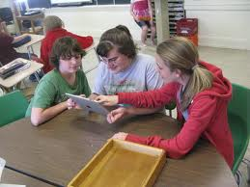
How we communicate is changing
21st century communication is different
  Talk more at a distance
  Showing pictures ~ Telling with AAC?
  Cell phone cameras, Facebook, text messaging
We live in a language-based world
  Language is changing
  Leveling of the playing field?
Notes:
Today when a kid wants to show us a show, or musician he’s excited about goes to his iPhone or his iPad. He pulls up a You Tube video of Justin Bieber. When he wants to tell us about his family he pulls up his photo album starts scrolling through it. The iPad is functional.
Our kids are seen as higher functioning now that they can share their experiences visually

Slide 28
Changes go beyond hardware and software
AAC-RERC (2012)
Needs of people with CCN
Changes in
social networks
Changes in
definition of
communication
Changes in
technology
Notes:
Changes in the nature of communication in the 21st century may actually play into the hands of our clients:
Texting / Facebook
Use of tech to communicate
Use of abbreviation expansion
Use of images as part of comm

Slide 29
Within a communication culture of change
AAC-RERC (2012)
AAC mobile computing
Typical
communication
Typical use
of pictures
(symbols &
photos)
Typical
language use
and form
Notes:
So technology has changed such that we find typical folks doing with mobile computing what our clients with CCN have been doing with their legacy technology…. Now it is cool

Slide 30

Technology
Consumer Products as AT
  IPhone/ Android Phones
  iPod Touch
  iPad
  Tablets
Notes:
Whereas before we had expensive customized devices
Sold relatively few so they were costly
Now presented with a number of new mobile technology tools

Slide 31
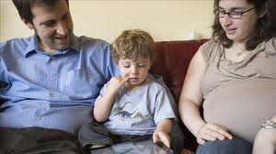
Technology
iPad is “go-to” AT product
  School administrators:
    less-expensive alternative to costly devices
  Parents:
    Greater awareness (consumer market product)
    Greater willingness to try AAC
Notes:
The iPad is the new go-to ATproduct administrators see it as a less expensive alternative parents have greater awareness and are willing to try AAC is a shift to high-tech solutions away from lower tech were no tech.
We are seeing more students coming into an AAC path than ever before

Slide 32
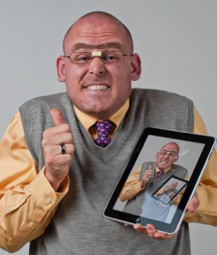
Technology
iPad is “go-to” AT product
Students: Motivation
  Shift to high tech solutions
  Away from lower tech stand-bys
Teachers:
  Enthusiasm from early adopters
  Some hesitation (as with all tech)
Notes:
The iPad is the new “go-to” AT product
Administrators see it as a less expensive alternative
Parents have greater awareness and are willing to try AAC
This is a shift to high-tech solutions away from lower tech or no tech.
We are seeing more students coming into an AAC path than ever before

Slide 33

Media and Technology
60 Minutes TV Show, Oct.23, 2011
http://www.cbsnews.com/video/watch/?id=7385686n
Or Google: ”60 Minutes Autism Augmentative Communication”
Notes:
Show featured individuals with Autism using iPads with ProLoquo2Go… some successfully. Others not….
Pretty fair assessment. Not a panacea…
A lot more goes into selecting a speech system for an individual.

Slide 34
Apps and Mobile Tablets as AAC: PRO’s
Apps are low cost and easily acquired comparatively speaking.
There is a “Normalization” factor that has taken the mystique out of AAC.
AAC is likely to reach out to many more users, for example someone who has temporarily lost her ability to speak.
AAC may appeal to families of very young children, individuals with autism and others who may not traditionally have thought about AAC helping to make it more acceptable and common place.
They are multi-functional making their appeal enhanced because they offer ongoing access to information, social interactions, entertainment, music and games.
More people are talking about AAC and accepting it. It is becoming normalized.
Posted by Glenda Hampton Anderson http://atclassroom.blogspot.com/2011/02/augmentative-alternative-communication.html, retrieved Sept 18, 2013

Slide 35
Apps and Mobile Tablets as AAC: CON’s
At least 75% of AAC Apps are developed by individuals/teams with little-to-NO background in communication.
Most Apps are simply a picture with a speech component or text that talk. For a developing child/emerging communicator – there is no language development in having just a talking picture.
Technical support is often lacking as are updates.
A company rep does not come out to you to help you assess the best tool, the best access method, or provide a trial, etc.
There is a lack of quality control so the buyer needs to be careful.
Less customization opportunities are available. You pretty much get what you see and what you see is not individualized.
Posted by Glenda Hampton Anderson http://atclassroom.blogspot.com/2011/02/augmentative-alternative-communication.html, retrieved Sept 18, 2013

Slide 36
Apps and Mobile Tablets as AAC: CON’s
Support in choosing the correct system by matching the attributes of the program to the needs of the client is usually not being used (individuals or family members are sometimes making decisions based solely on what they have seen, heard or read).
Lacking the process and consideration of training, technical support and follow up.
There are challenges with mobile devices themselves, such as glare, ruggedness, sound, and system back-up.
Posted by Glenda Hampton Anderson http://atclassroom.blogspot.com/2011/02/augmentative-alternative-communication.html, retrieved Sept 18, 2013

Slide 37
Apps and Mobile Tablets as AAC: CON’s
Distracting- many options at your fingertip may cause client to venture away from communication purpose.
Possible hidden costs in monthly service agreements often sneak up.
They are NOT dedicated devices meaning they are not approved for funding by private medical insurance, Medicaid or Medicare in most states like dedicated devices.
Posted by Glenda Hampton Anderson http://atclassroom.blogspot.com/2011/02/augmentative-alternative-communication.html, retrieved Sept 18, 2013

Slide 38

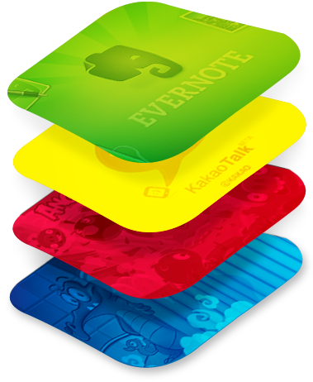
Android App Player for PC
BlueStacks App Player: lets you run apps from your phone fast and full screen on Mac and Windows.
HTTP://www.BlueStacks.com
Notes:
Your PC emulates/ looks like a Samsung Galaxy Tablet
Log in with gmail account just like any android device
Download and try out apps (still have to pay for them)
Demo BlueStacks App Player

Slide 39
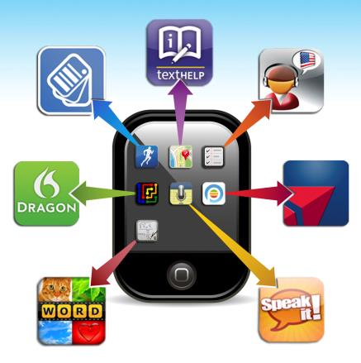
GATFL APP Finder
Search by:
App Name
Categories
  Book
  Education
  Environmental Adaptations
  Hearing
  Cognition, Learning, Developmental
  Navigation
  Personal Care and Safety
  Productivity
  Communication
  Therapeutic Aids
  Vision

Slide 40
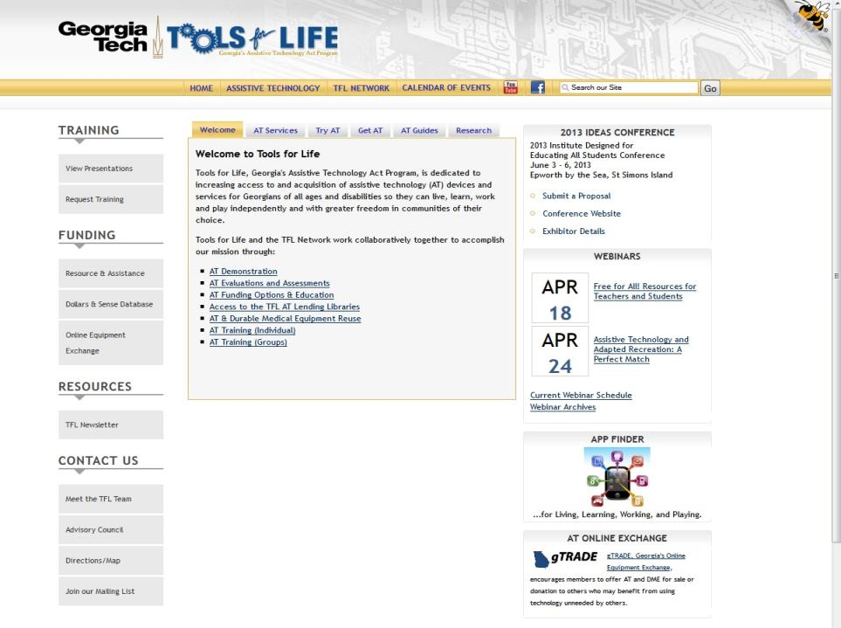

Slide 41
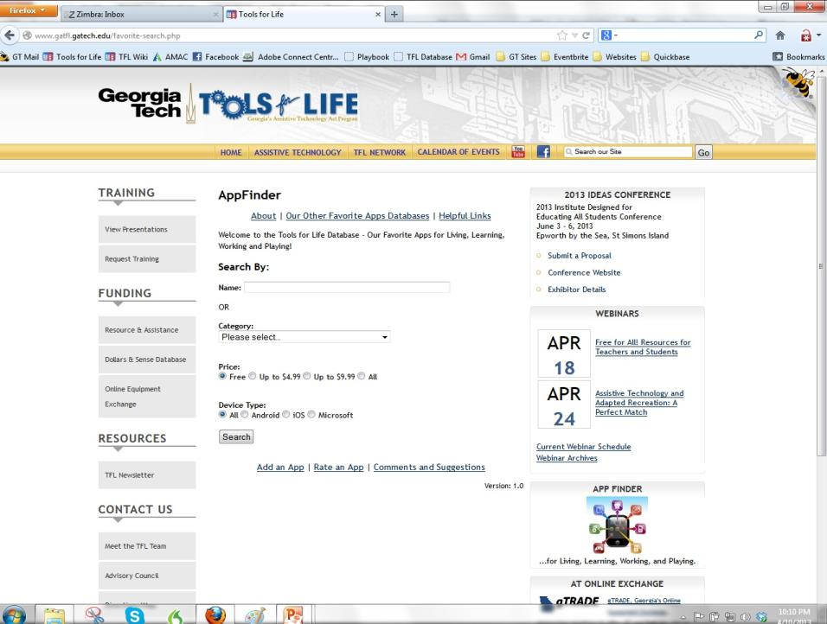

Slide 42
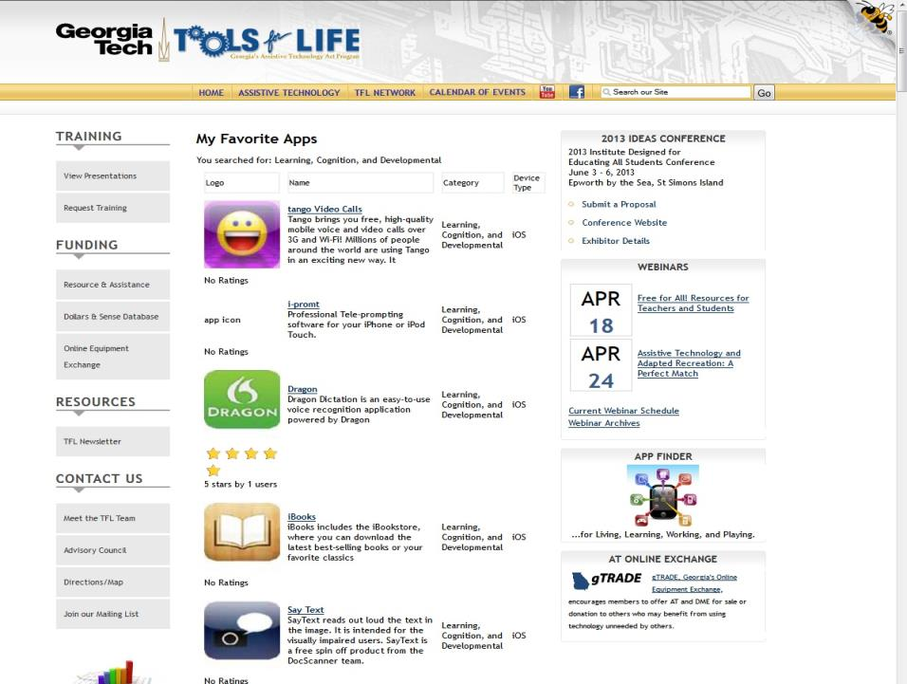

Slide 43

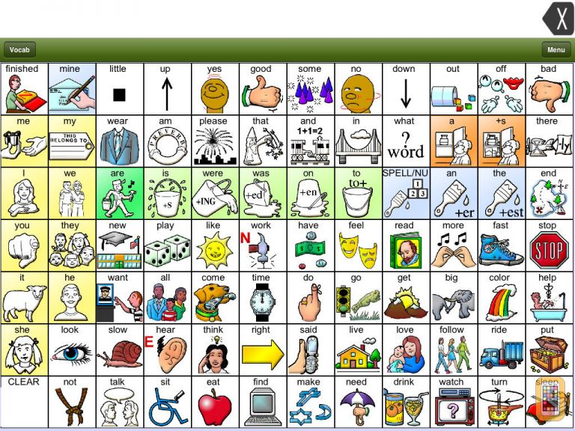
LAMP: Words for Life
PRC Unity® language system
Utilizes Language Acquisition through Motor Planning (LAMP™) principles and strategies
Provides a consistent motor pattern for words
Vocabulary, structure, and teaching approach are based on research and years of implementation with individuals with autism and other developmental disabilities
iSharePRC allows back-up and sharing of vocabulary files as well as converting files from dedicated PRC devices to use on application.

Slide 44

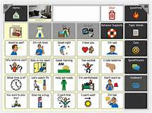
Tobii Dynavox Compass
Access to pre-stored phrases, core words, and keyboard for message generation.
Jump into the conversation with QuickFires and QuickPhrases.
Additional built-in supports such as Behavior Supports and Scripts
Multiple Languages available
Gateway and PODD premium pagesets available for purchase
Programming available remotely on editing software, file transfer and sharing available via Tobii Dynavox account.
Scanning/switch accessible

Slide 45

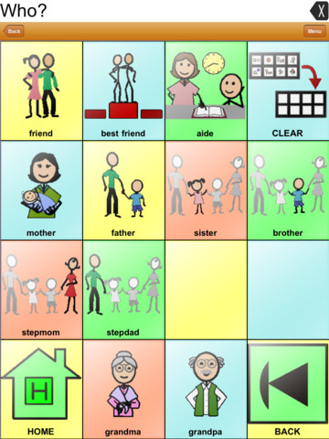
Touch Chat
3 versions; TouchChat HD-Lite, Touch Chat HD-ACC, TouchChat HD-AAC Word Power
Customization available within application and remotely using Chat Editor software
Vocabulary file transfer and sharing available through iTunes and ishareservices.
Text generated with TouchChat pages can be shared on social media
English and Spanish options
Communication via pre-stored messages, core words, and keyboard.
Adjustments include button dwell time and button release time; ability to hide buttons
Scanning/switch accessible

Slide 46

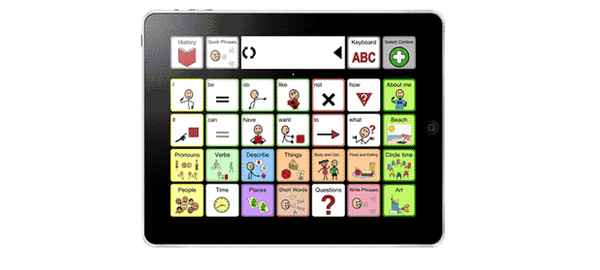
SonoFlex
Combines core and topic-based vocabulary in a unique and dynamic way
Provides an easy, and highly motivating, start with over 50 pre-made context vocabularies
Symbolstix and/or imported photos
Customizable only on the device.
Color coding based on Fitzgerald Key
Requires ability to swipe through pages to locate desired vocabulary/message
Tobii Sono Flex is available for iPhone,
iPod, iPad
Sono Flex Lite version available for free with fewer context based vocabularies

Slide 47
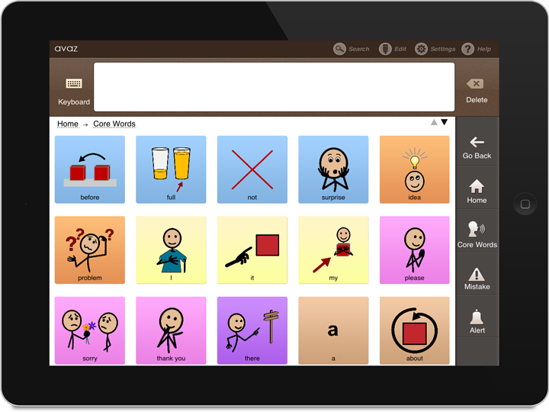
Avaz for Autism (AAC)
Pre programmed with 5 category folders; Quick, Core Words, Getting Started, Basic (1), and Advanced (2)
Color Coding based on the Fitzgerald Key
Alert Button to bring attention to the user
Mistake Button – for user self-correction
Symbolstix or import your own images
Ability to add/customize categories and vocabulary
Voice choices (male, female, child) or record your own
Share social messages using email, Facebook, Twitter
Measure the child’s progress with Avaz analytics, presented as easy to understand graphs
Comprehensive settings that include; tips, adjustment of cell number (1-24), caption size, high contrast (black background), starting screen choice, and much more
Easy backup and restore using iTunes and Dropbox

Slide 48
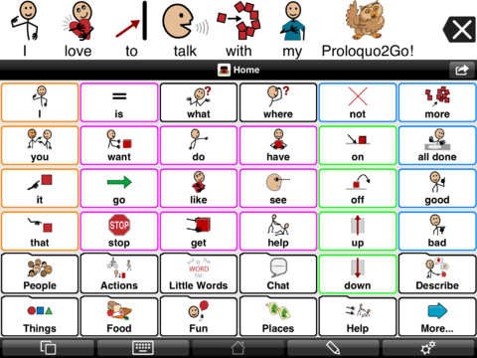

ProloQuo2Go
Standard Version: Crescendo vocabulary available in 3 levels; basic, intermediate, advanced communication.
Gateway to Language & Learning© core word vocabulary available as in app purchase
Custom color coding on Crescendo and Fitzgerald Key color coding on Gateway
SymbolStix symbols included
Set up two languages for bilingual users.
Customization options on device
Scanning/switch accessible
Backup and sync options via Dropbox
Manual & help videos available

Slide 49

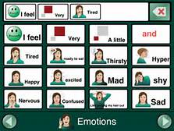
GoTalk NOW
GoTalk NOW is a full-featured, customizable AAC app for the iPad,
Ideal for both the beginner and experienced communicator.
Easy-to-use, touch-based editor.
Use Imagine Symbol set or your own pictures.
GoTalk Lite available (free) – 5 customizable pages
GoTalk NOW – unlimited pages, 1 text to speech voice, in-app purchases for extra voices
GoTalk PLUS – includes Symbolstix Library and Acapela text to speech voices.
Scanning/switch accessible

Slide 50

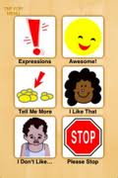
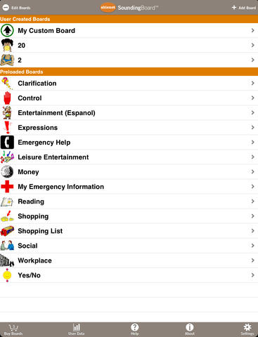
SoundingBoard
FREE app which allows you to create communication boards on your iPad or iPod touch.
Pre-loaded communication boards and in-app purchases available for editable boards.
Use your own photos, or access the AbleNet symbols.
Record your own messages on each button (unlimited recording time).
Switch accessible
Offers basic data collection on application usage
Latest version now allows you to import and export communication boards

Slide 51

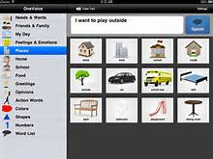
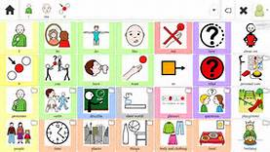
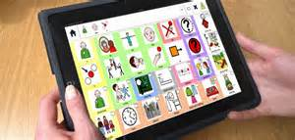
CoughDrop
Simple AAC app that empowers individuals and the teams around them.
Runs on multiple devices, so you can log in on your tablet, phone or computer and have access to the same communication tools and interface.
Can be installed without being purchased, but a web site subscription ($200/ 5 yr license or $7/mo.) is required after the two-month trial period has ended.

Slide 52
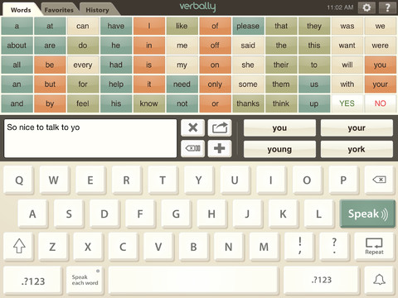

Verbally Premium
Text-based communication app available for both iPhone/iPod Touch and iPad.
FREE version of this app, available but does not include all voices and features of Verbally Premium.
Uses a Word grid of 50 commonly used words as well as a keyboard.
Word prediction with integrated learning of words.
High-quality Acapela text-to-speech voices.
Save customized sentences/phrases and organize by category
Share messages via email.

Slide 53

Speak It!
Copy emails, documents, web pages, PDF files, and more; paste them into Speak it!, and have the text spoken back to you.
Email text to speech files
Make announcements over PA system
Endless phrases and possible uses
$1.99

Slide 54
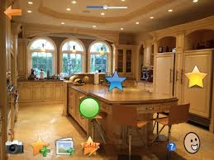
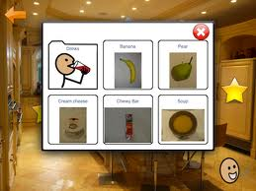

AutisMate
A comprehensive communication and behavior tool, with Visual Scene Displays, choice boards and symbol-based grid AAC set. Other visual tools to support behavior and social skills are also included. It is designed for the iPad.
Access to SymbolStix library, and easily add your own photos and videos.
Video modeling, visual schedules, visual stories and other behavioral tools are included within the app.
Personalization and customization is quick and easy.
A LITE version is available to try the app out.
Share all content via email from within the app.

Slide 55
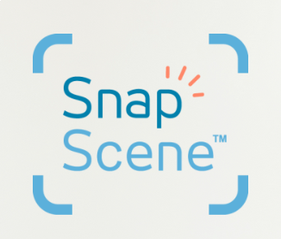
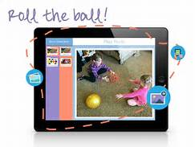
Snap Scene
Take a photo and tag it with recordings to let your child communicate on the fly.
Natural and intuitive navigation between scenes – no training is required to use the program
Tap on a hotspot and the word/phrase appears on the screen when spoken – this reinforces word meanings and literacy
Runs on iPad and on Windows devices
Available in 8 languages
Recordings are in a familiar voice that’s recognizable to your child.
Free trial with access to 10 scenes

Slide 56

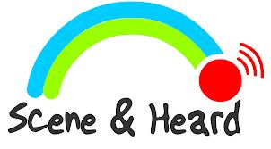
Scene & Heard
Scene & Heard supports communication and learning through the use of Visual Scene Displays and is designed for iPad and iPod touch.
Make scenes using your own photos, and also access Widgit symbols.
Record your own voice messages for scenes.
Switch Accessible
Share your scene on Facebook or Twitter
Link hotspots on page to photos and videos.

Slide 57
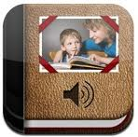
Pictello
Create "storybooks"
Talking photo albums
Use images in your device's photo library.
Easy-to-use
  Choose a picture for each page,
  Type in text, Have that text read by a computerized narrator,
  or record yourself reading it
  Photo books can be shared

Slide 58
Talk with us!
What are your favorite Apps?

Slide 59
Continuing the Conversation
Ben Satterfield
ben@c4atx.com
Krista Mullen
krista.mullen@gatfl.gatech.edu

Slide 60
Webinar Evaluation
At the end of today’s webinar, we ask that you please take a moment to complete our survey:
https://www.research.net/s/TFLwebinar

Slide 61

Evaluating Apps for AAC
(Y. Lachelle, Aug., 2010)
Notes:
As responsible SLPs, we should be alert to the overuse and flurry of recommendations for iDevices as they relate to replacing intervention with a certified SLP and dedicated AAC devices. In many cases these devices fall short: the iDevice doesn't provide appropriate feedback, the application freezes, the volume is not sufficient in many environments, the hardware is quite fragile, or access options for those with motor challenges are limited (Farrall, blog 2011). As SLP Jane Farrall states, "I could spend a lot of time trying to ‘make' this technology work for someone when there is a piece of specifically designed technology that will work straightaway."

Slide 62
Growth in Apps Available in iTunes App Store

Slide 63
Apple iTunes App Store Metrics
In May of 2013, Apple reported that over 1053 new apps were submitted that month.
Customers are downloading more than 800 apps per second and at a rate of over two billion apps per month on the App Store.
The 50 billionth app was downloaded by Brandon Ashmore from Mentor, Ohio on May 16th, 2013 (Say the Same Thing by Space Inch, LLC).

Slide 64
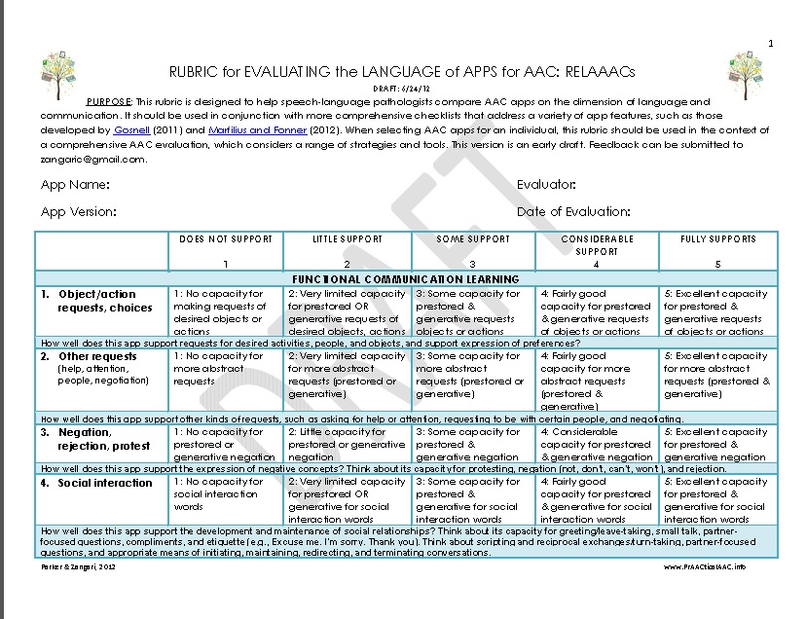
Rubric for Evaluating the Language Aspects of the AAC App
(Parker & Zangari , 2012 )
(Parker & Zangari , 2012)

Slide 65
Process to Making an Informed iDevice/App Purchase
Gosnell, J., Costello, J., & Shane, H. (2011, September). Using a clinical approach to answer “what communication Apps should we use?”. Perspectives on Augmentative and Alternative Communication, 20, 87–96.

Slide 66
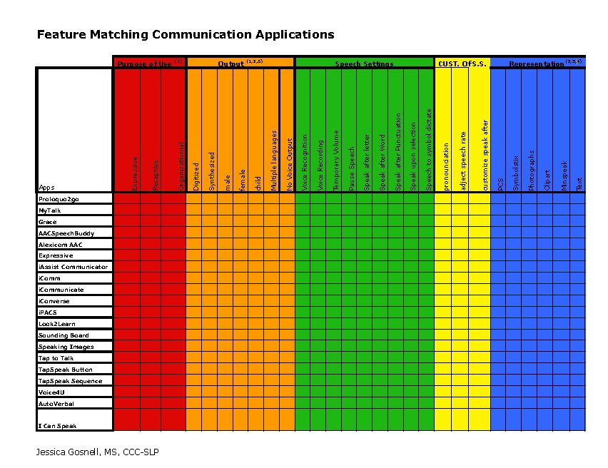
Apps Feature Matching

Slide 67
Case example:
Key needs/ features based on assessment outcomes
 | Information Gathered During Assessment | Key Features Based on Information Gathered During Assessment
Representation | • Recognizes and can make choices using familiar photographs • Inconsistently using PCS icons | • Photographs • Ability to import photographs
Display Settings | • Was not able to navigate dynamic displays • Used grid-based topic display in Go-Talk successfully • Benefited from symbol spacing | • Static displays (basic dynamic component) • Edit field and symbol size • Edit symbol spacing • Hide buttons
Access/Motor | • Inconsistently producing an isolated point • Keyguard reduced unintentional selections | • Adjust dwell • Edit symbol size and spacing • Direct Selection
Purpose of Use | • Preference indication • Aided language stimulation opportunities (expanding beyond requesting and modeling 2 symbol combination) • Social engagement (turn-taking, sharing information) | Expressive tool • Voice output (digitized or Synthesized) • A Go-Talk was recommended. In order for carry-over and consistency of targeted skills, boards should be as similar as possible • Boards with the ability to expand beyond choice-making
Notes:
Case Study #1:
Assessment findings for Ronan, summarized in Table 4, include the need to use
photographs and the ability to customize and import personal photographs; this relates to
representation and customization of representation categories of the chart (Table 3). In
addition, this child did not demonstrate the ability to use the dynamic features of a device in
order to navigate and did best with a reduced field size with symbols spaced apart. This relates to the display settings category of the chart (Table 3). Regarding motor and access, Ronan was
using direct selection. He would benefit from the ability to change/increase dwell due to motor
control issues and greater target spacing on the display, findings that relate to display,
customization of the display, and access/customization of access categories of the chart (Table
3). Last, the purpose of the app was for expressive communication and social participation;
therefore, voice output was needed. Whether the voice choice was digitized or synthesized was
not a determining factor.
Ronan’s family had previously purchased an iPad and indicated a strong desire to use it
for purposes of communication. The SLP recommended use of a Go-Talk in the pre-school
setting and a Step-By-Step in the pre-school setting and to share information between home
and school, expanded use of photographs for requesting, and use of basic toy displays to
engage Ronan in and model communicative intents such as , directing and commenting. The
iPad was recommended for direct instruction and aided language stimulation.

Slide 68
Key features compared
Notes:
For the purpose of applying the logic of the chart, eight applications were selected (e.g.,
Sounding Board, Proloquo2go, Assistive Chat) and compared to the app features found to be
critical (expressive tool, use of photographs, ability to edit the field size on a horizontal axis).
The appropriate column was marked on the chart if the app contained a desired feature. The
app ultimately having the greatest number of features was selected for trial. In Ronan’s case,
Sounding Board (created by Ablenet) was selected as the most appropriate communication app,
because the available features best matched Ronan’s identified needs (see Table 5).

Slide 69
Key Needs/Features Based on Assessment Outcomes
 | Information gathered during assessment | Key App Features based on information gathered during the assessment
Representation | Text | Text
Rate Enhancement | Doesn’t not want to “write every letter out” | Word Prediction Abbreviation Expansion Logical Letter Encoding Ability to store Phases/Retain Codes
Display Settings | Was able to navigate dynamic displays Wants something with “little set up” Able to use QWERTY keyboard Increase font size | QWERTY Keyboard Increase font size
Access/Motor | Able to type on iPad and other devices No current motor issues (yet could potentially have motor issues in the future) | Adjust dwell Edit icon size and spacing Direct Selection
Purpose of Use and Patients “requests” | Communication in multiple contexts Wants voice output and a female’s voice | Synthesized Speech (voice output) Female Voice Adjust rate Speak after selection
Notes:
Case Study #2:
Nancy, a 69-year-old woman with Bulbar ALS was seen in August 2010
In Nancy’s case, the iPad is a tool that meets most of her communication needs, serving as her primary communication system. Recommendations in addition to the iPad during the AAC consultation included use of pen and paper (for written messages) and a low-tech alphabet board. Yet the iPad will be used as her primary tool due to the voice output features, ability to pre-store messages, and word prediction (thus enhancing the rate of communicative interactions). Assistive Chat was selected as the primary communication app, matching key features that Nancy needs within her price range

Slide 70
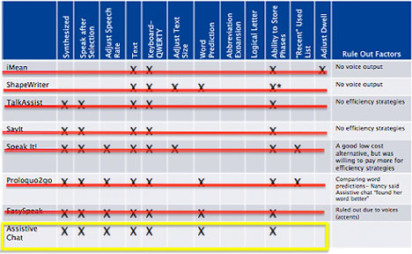
Notes:
In Nancy’s case, both Prolqou2go and Easy Speak had just as many “matched” features to the final app choice. Yet in trialing them in the assessment with Nancy, she voiced a clear preference for Assistive Chat (due to quality of voice and what she described as “the best prediction”); thus stressing the importance of gathering functional evidence based upon clinical trial.

Slide 71

Questions

